Slide 1

Concept Map v2.0
Assignment 4

Slide 2
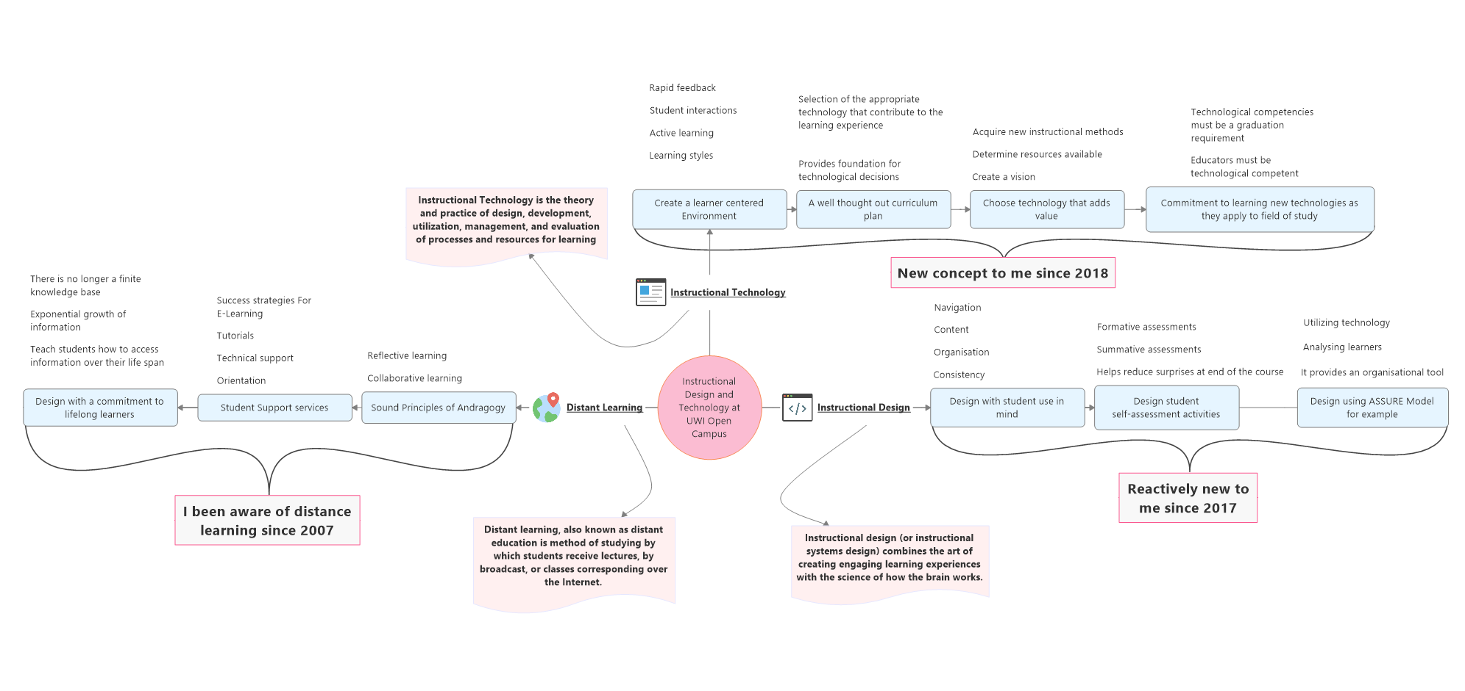

Concept map one
What I knew…
Notes:
Concept maps

Slide 3
Instruction technology
Instructional Technology is the theory and practice of design, development, utilization, management, and evaluation of processes and resources for learning.

Slide 4
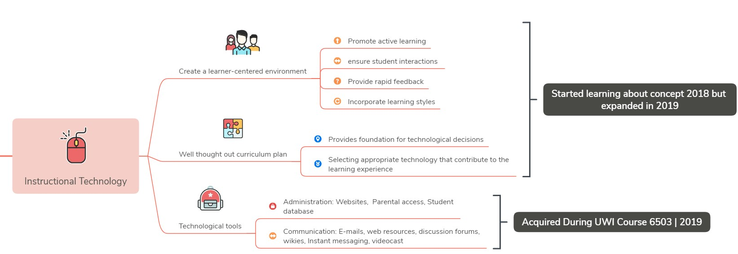
Title:
Technological tools
Instructional Technology
What I know now
Communications (e-mail, blogs, Web resources, discussion forums, wikis, whiteboards, instant messaging, podcasts, video casts, etc.)
• Administration: Access to information and authority to input information based on role and information type,
• General student data e.g. address, attendance

Slide 5
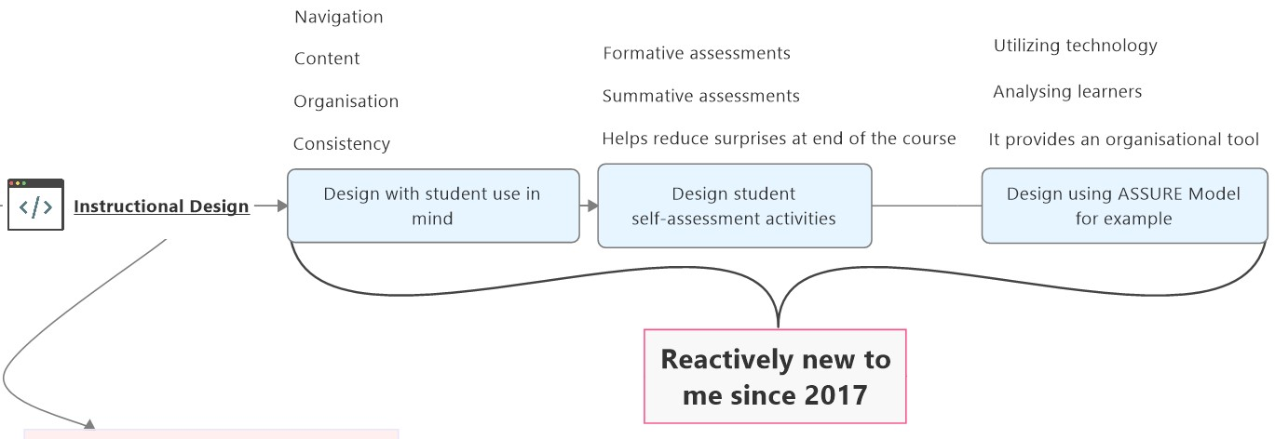
Instructional Design
Instructional design (or instructional systems design) combines the art of creating and engaging learning experience with the science of how the brain works.

Slide 6
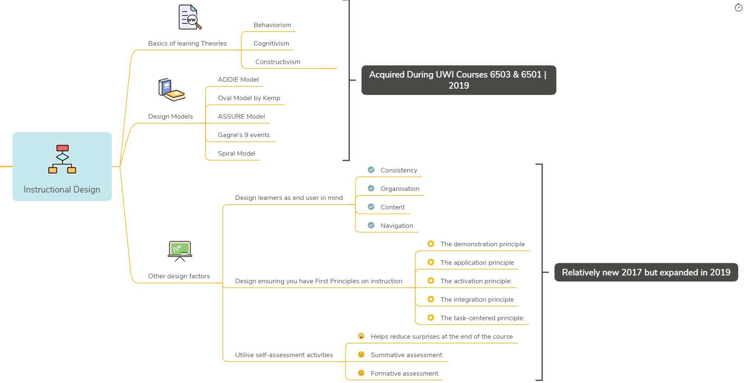
Title:
Learning theories, Design models and strategies
Instructional Technology
What I know now
Behaviorism, Cognitivism and Constructivism
Various models: ADDIE, OVAL Model, ASSURE, Gagne’s 9 Events, Spiral

Slide 7
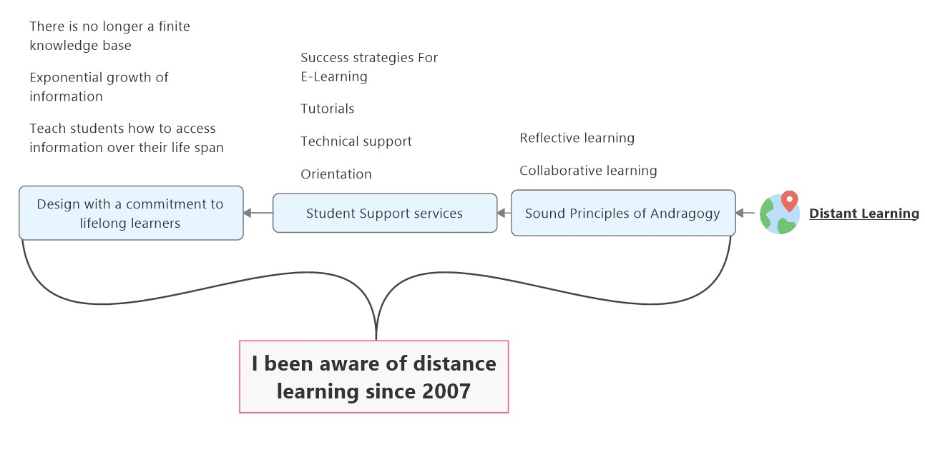
Distance learning
Also known as distance education is the method of studying by which students receive lectures, by broadcast, or classes corresponding over the internet

Slide 8
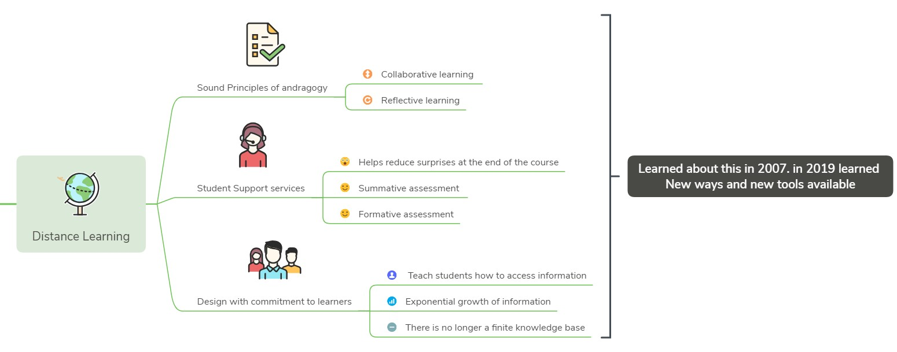
Title:
New tools and features
Distance learning
What I know now
Essentially the same except newer tools and features are available now.

Slide 9
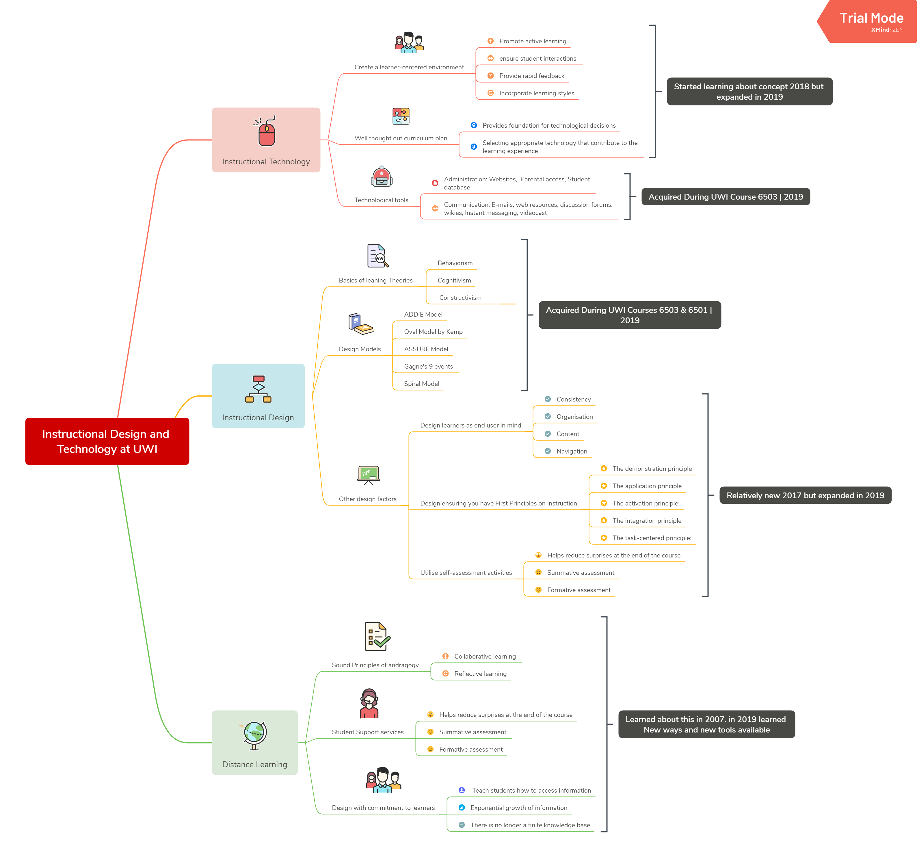
YOUR TITLE
GOES HERE 2
SUBTITLE GOES HERE
Notes:
Now the remade Concept Map. Cleaner look,

Slide 10
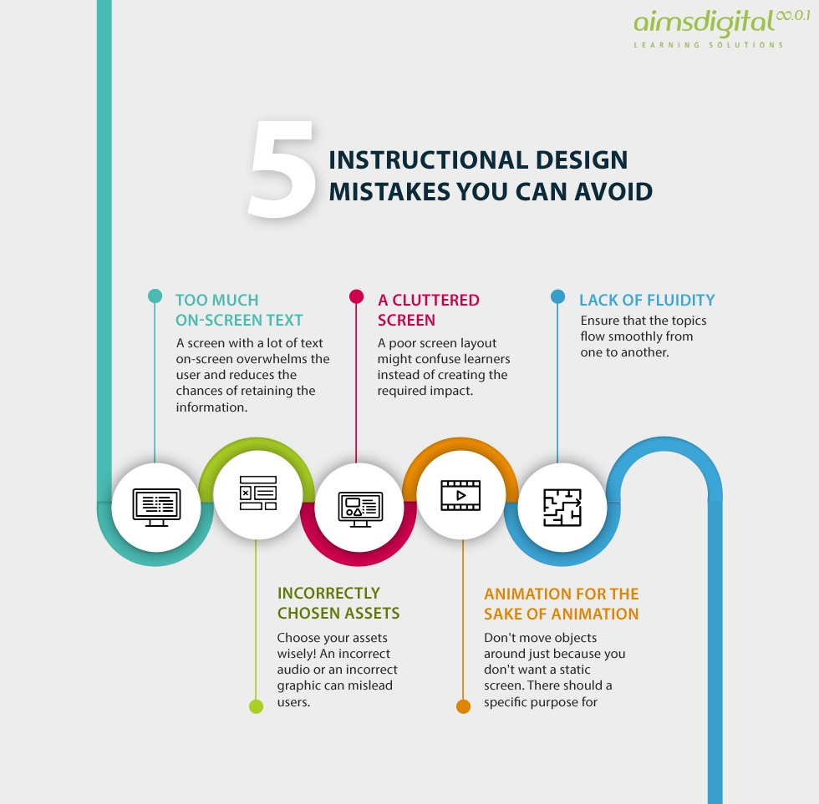
Summary
All in all there has been much gathered in the past eleven weeks.
Increased my knowledge on Instructional Design
Widen my scope on Instructional Technology
Exposed me to new features used in the online learning environment
Gave me a connected theories, models into common knowledge based.

Slide 11
THANK YOU
Any Questions?

Slide 12
References
Kurt, S. (2018, February 18). Definitions of Instructional Technology. Retrieved from Education Technology: https://educationaltechnology.net/definitions-of-instructional-technology/
Pultar, K. (2010, April 18). Ten Guiding Principles of Instructional Technology and Disaster Education. Retrieved September 2019, from https://youtu.be/JHa-gzBGS4c
TechTarget. (2005, September). Definition: distance learning (e-learning). Retrieved from TechTarget: Introduction to Learning Theory and Instructional Design
UWI OC. (2019). Introduction to Learning Theory and Instructional Design. In Learning Theory and Instructional Design (pp. 3-20). Barbados.
Kelly, J. (2012). Learning Theories. Retrieved from Educational Learning : http://thepeakperformancecenter.com/educational-learning/learning/theories/

