Slide 1

Develop a lesson for a course
Inclusive and Instructional Strategies

Slide 2

Instructional Sections Outline
Section 1.
Activation principle
Section 2.
Demonstration Principle
Section 3.
Task-Centered Principle
Section 4.
Application Principle

Slide 3
Session Objectives
Objective 1.
Activating the emergency response system using procedures outlined by the facilitator
Objective 2.
Giving rescue breaths using correct techniques for adult, child and infant using
Objective 3.
Performing 1 and 2 rescuer CPR for adult, child and infant using appropriate skills guidelines
Objective 4.
Using an AED for casualties over the age of 1 with no more than one redirection

Slide 4

Activation Principle
Now that we have described the steps in the chain of survival can anyone recall what step performing CPR falls at?

Slide 5
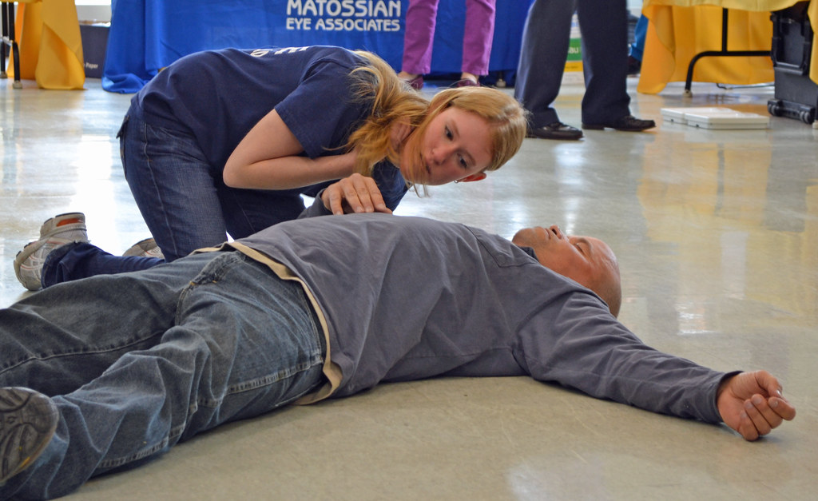
Demonstration Principle
Students will observe the facilitator perform the sequence of simulating the activating the Emergency Response System, and perform Adult CPR

Slide 6
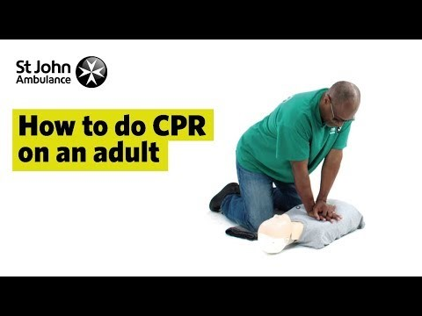
Demonstration Principle
Students will view this video sequence of the activating the Emergency Response System, and perform Adult CPR.

Slide 7

Task-centred Principle
Let’s Practice the steps. Remember:
Checking the scene
Checking for responsiveness and looking for breathing
Giving compressions
Giving rescue breaths
Using an AED
Break into groups of three and each person demonstrates one cycle of Adult CPR while the others observe and provide feedback.
Notes:
Task-centred Principle

Slide 8

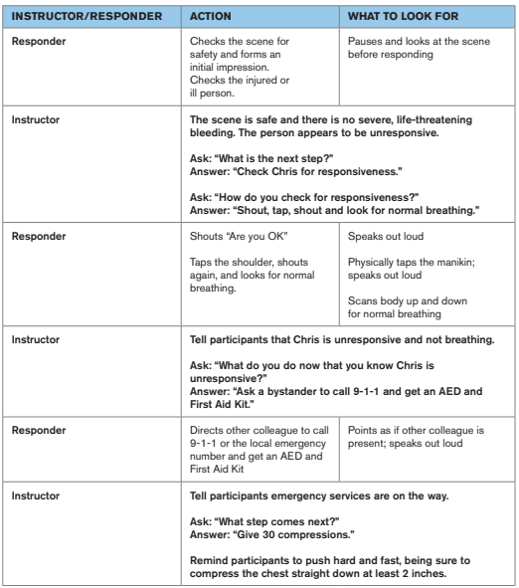
Example: Task prompt practice guide

Slide 9

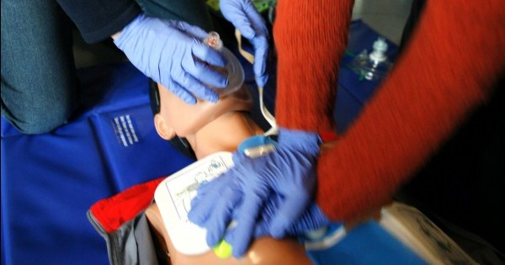
Application Principle-Learners will be assessed as they:
Consider safety and activate EMS
Demonstrate accurate rescue breaths for Adults
Demonstrate accurate chest compressions for adult
Notes:
Explain to participants that the Learning Assessment will take them back
to the emergency at the Anguilla vs. St, Marten football match for a final time. They will
be prompted only on the conditions they find. This assessment will test
their ability to independently go through the mission and apply the skills
they learned.

Slide 10
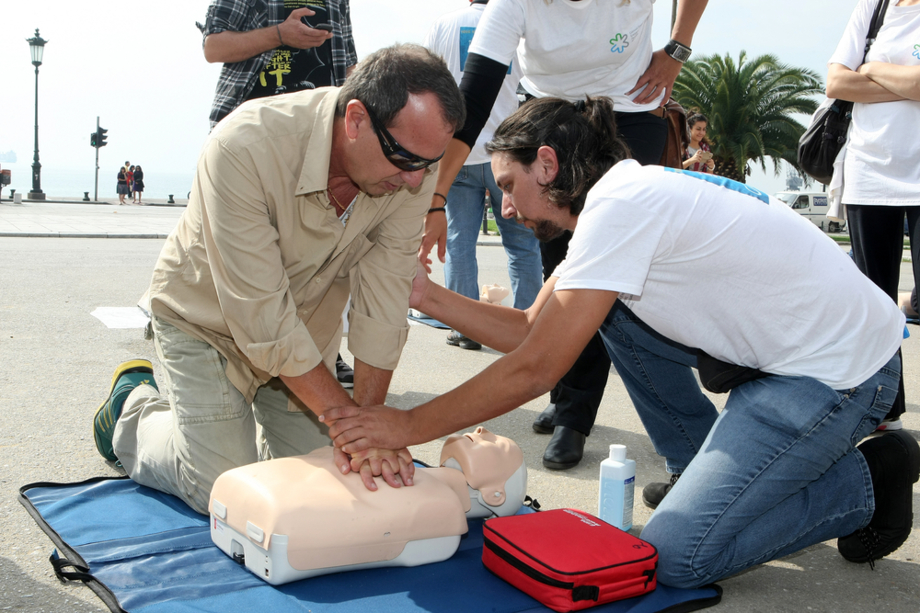
Assessment Scenario
You are covering an football match at the stadium overhear two referees chatting about weekend plans. The older referee, Chris, abruptly stops speaking and appears pale. When asked what is wrong, he insists he just skipped lunch. But seconds later, Chris grabs his chest and falls to the ground.
Use the skills you’ve learned to respond to this emergency.

Slide 11
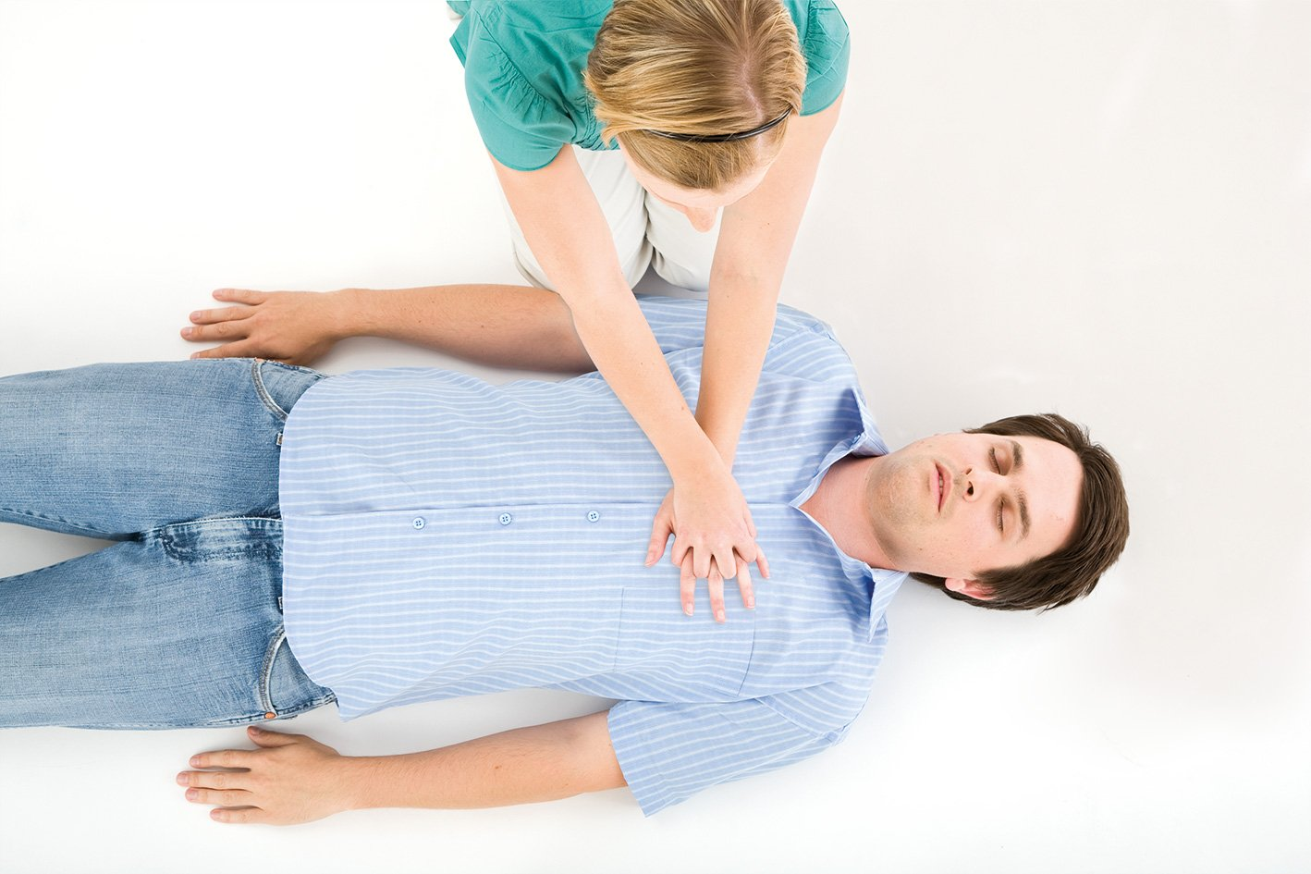
Summary
Instructional Strategies used:
  Pair-to-Pair guide
  Direct Instructions
  Demonstrations
  Multimedia
  Group/collaborative work
Activation principle
Demonstration Principle
Task-Centered Principle
Application Principle

Slide 12

References
American Red Cross. (2016). First Aid CPR AED. Retrieved March 15, 2020, from Red Cross Learning Centre: https://www.redcrosslearningcenter.org/s/phss-program/a0sd000000AI1eEAAT
American Red Cross. (2020, March). First Aid/CPR/AED. Retrieved from Red Cross learning Centre: https://www.redcrosslearningcenter.org/s/phss-program/a0sd000000AI1eEAAT.

Slide 13

Thank You!
Our Next session is CPR on Child and Infant.

